Slide 1

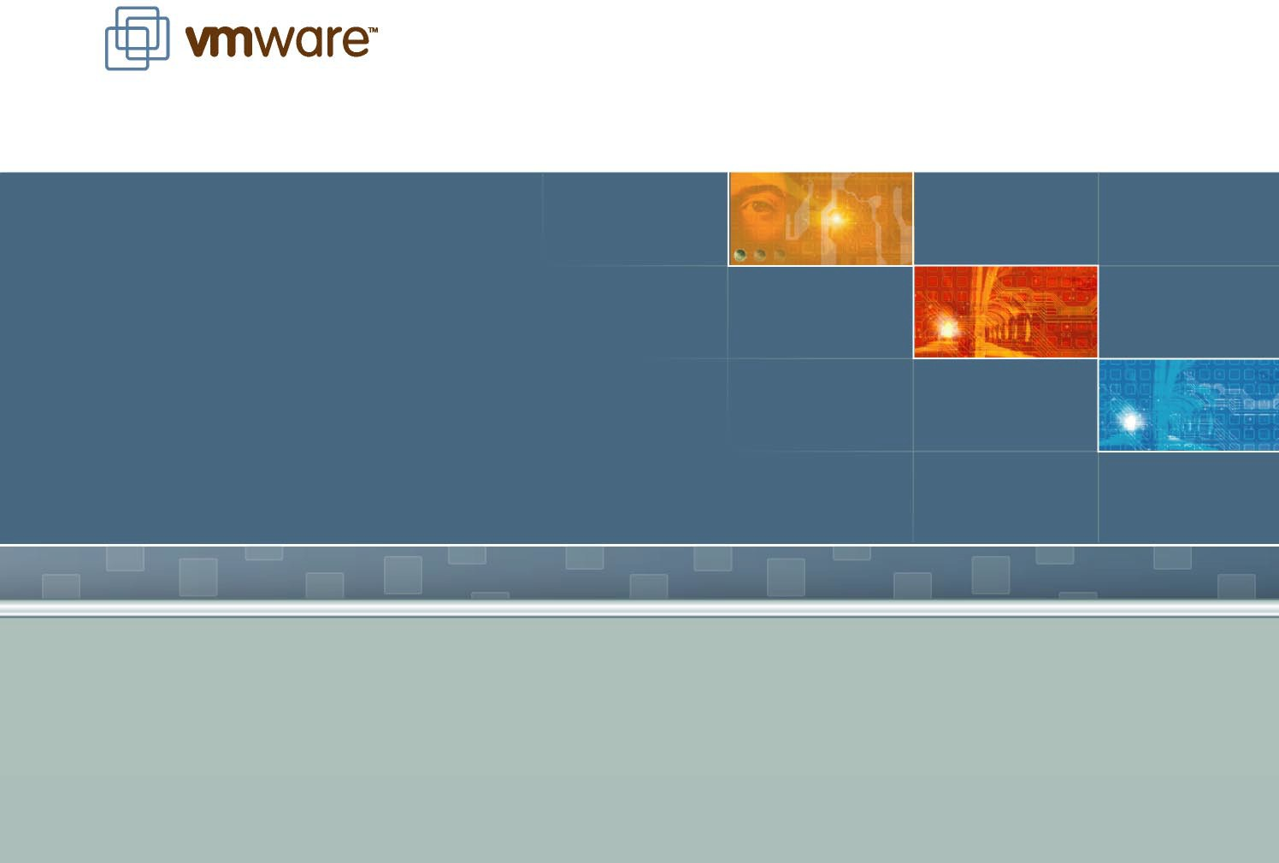
Memory Resource Management in VMware ESX Server

Slide 2
Overview
Context
Memory virtualization
Reclamation
Sharing
Allocation policies
Conclusions

Slide 3
Motivation
Server consolidation
Many physical servers underutilized
Consolidate multiple workloads per machine
Virtual machines
illusion of dedicated physical machine
Encapsulate workload (OS + apps)
iBM VM/370 [Creasy '81], Oisco [Bugnion '97], VMware [Sugerman '01]
Resource management
Fairness, performance isolation
Efficient utilization

Slide 4
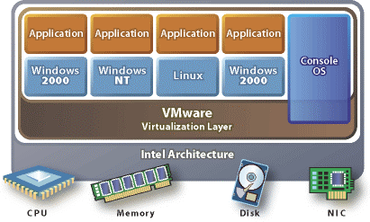
ESX Server
Commercially-available product
Thin kernel designed to run VMs
Multiplex hardware resources
High-performance i/O

Slide 5
Memory Virtualization
Traditional VMM approach: extra level of indirection
virtual → "physical" guest maps VPN to PPN
"physical" → machine pmap maps PPN to MPN
Ordinary memory refs: hardware maps VPN to MPN
VPN
guest
hardware page table
hardware TLB
PPN
pmap
MPN

Slide 6
Reclaiming Memory
Traditional: add transparent swap layer
Requires meta-level page replacement decisions
Best data to guide decisions known only by guest OS
Guest and meta-level policies may clash
Example: "double paging" anomaly
Alternative: implicit cooperation
Coax guest into doing page replacement
Avoid meta-level policy decisions

Slide 7
Ballooning
inflate balloon (+ pressure)
may page out to virtual disk
Guest OS
balloon
Guest OS
guest OS manages memory implicit cooperation
balloon
may page in from virtual disk
Guest OS
deflate balloon (- pressure)

Slide 8
Ballooning Details
Guest drivers
inflate: allocate pinned PPNs; backing MPNs reclaimed
Use standard Windows/Linux/BSO kernel APis
Related: Nemesis "self-paging" [Hand '99], Collective [Sapuntzakis '02]
Performance benchmark
Linux VM, memory-intensive dbench workload
Compare 256 MB with balloon sizes 32 - 128 MB vs. static VMs
Overhead 1.4% - 4.4%
Some limitations

Slide 9
Sharing Memory
Motivation
Multiple VMs running same OS, apps
Collapse redundant copies of code, data, zeros
Transparent page sharing
Map multiple PPNs to single MPN copy-on-write
Pioneered by Oisco [Bugnion '97], but required guest OS hooks
New twist: content-based sharing
General-purpose, no guest OS changes
Background activity saves memory over time

Slide 10
Page Sharing: Scan Candidate PPN
011010 | hash page contents
110101
010111
101100
.2bd806af
VM 1
VM 2
VM 3
hint frame
Machine Memory
Hash: .06af VM: 3 PPN: 43f8 MPN: 123b
hash table

Slide 11
Page Sharing: Successful Match
VM 1
VM 2
VM 3
shared frame
Machine Memory
Hash: .06af Refs: 2 MPN: 123b
hash table

Slide 12
Page Sharing Performance
"Best-case" workload
identical Linux VMs
SPEC95 benchmarks
Lots of potential sharing
Metrics
Total guest PPNs
Shared PPNs → 67%
Saved MPNs → 60%
Effective sharing
Negligible overhead
400
300
200
100
0
1 2 3 4 5 6 7 8 9 10
Number of VMs
Memory (MB)

Slide 13
Real-World Page Sharing
 |  | Total | Saved
Workload | Guest Types | MB | MB | %
Corporate iT | 10 Windows | 2048 | 673 | 32.9
Nonprofit Org | 9 Linux | 1846 | 345 | 18.7
VMware | 5 Linux | 1658 | 120 | 7.2
Corporate iT - database, web, development servers (Oracle, Websphere, iiS, Java, etc.) Nonprofit Org - web, mail, anti-virus, other servers (Apache, Majordomo, MailArmor, etc.) VMware - web proxy, mail, remote access (Squid, Postfix, RAV, ssh, etc.)

Slide 14
Allocation Parameters
Min size
Guaranteed, even when overcommitted
Enforced by admission control
Max size
Amount of "physical" memory seen by guest OS
Allocation when undercommitted
Shares
Specify relative importance
Proportional-share fairness

Slide 15
Allocation Policy
Traditional approach
Optimize aggregate system-wide metric
Problem: no QoS guarantees, VM importance varies
Pure share-based approach
Revoke from VM with min shares-per-page ratio [Waldspurger '95]
Problem: ignores usage, unproductive hoarding [Sullivan '00]
Oesired behavior
VM gets full share when actively using memory
VM may lose pages when working set shrinks

Slide 16
Reclaiming Idle Memory
Tax on idle memory
Charge more for idle page than active page
idle-adjusted shares-per-page ratio
Tax rate
Explicit administrative parameter
0% ≈ "plutocracy" . 100% ≈ "socialism"
High default rate
Reclaim most idle memory
Some buffer against rapid working-set increases

Slide 17
Measuring Active Memory
Experiment
Single Windows VM
Memory "toucher" app
Active memory estimate
Statistical sampling
Small random subset of pages
Software access bits [Joy '81]
Moving averages [Kim '01]
Behavior
Rapid response to ↑ usage
Gradual response to ↓ usage
Windows "zero page thread"
300
250
ZPT
Memory (MB)
200
150
100
50
0
0
10
20
30
40
Time (min)

Slide 18
Idle Memory Tax: 0%
Experiment
2 VMs, 256 MB, same shares
VM1: Windows boot+idle
VM2: Linux boot+dbench
Solid: usage, Ootted: active
Change tax rate
Before: no tax
VM1 idle, VM2 active
get same allocation
300
250
Memory (MB)
200
150
100
50
0
0
10
20 30
Time (min)
40
50
60

Slide 19
Idle Memory Tax: 75%
Experiment
2 VMs, 256 MB, same shares
VM1: Windows boot+idle
VM2: Linux boot+dbench
Solid: usage, Ootted: active
Change tax rate
After: high tax
Redistribute VM1 → VM2
VM1 reduced to min size
VM2 throughput improves 30%
300
250
Memory (MB)
200
150
100
50
0
0
10
20 30
Time (min)
40
50
60

Slide 20
Dynamic Reallocation
Reallocation events
Enforcing target allocations
Ballooning: common-case optimization
Swapping: dependable fallback, try sharing first
Reclamation states
High - background sharing
Soft - mostly balloon
Hard - mostly swap
Low - swap and block VMs above target

Slide 21
Conclusions
Key features
Flexible dynamic partitioning
Efficient support for overcommitted workloads
Novel mechanisms
Ballooning leverages guest OS algorithms
Content-based page sharing
Statistical working-set estimation
integrated policies
Proportional-sharing with idle memory tax
Oynamic reallocation

Slide 22
I/O Page Remapping
OMA from "high" memory
iA-32 PAE mode supports 36-bit addressing (up to 64 GB)
Many 32-bit i/O devices (low 4 GB only)
VM memory may be located anywhere
Copy when necessary
Conventional approach
Use temporary OMA "bounce buffer"
Oynamic page remapping
Keep copy statistics to identify "hot" pages
Transparently remap from high to low memory

